Slide 1


Slide 2
One person who chooses to be an organ and tissue donor can save or heal up to 83 lives.

Slide 3
Organ and Tissue Donor:
Someone who died and was able to donate organs to save up to eight lives and tissue grafts to provide healing for up to 75 others.
Common Donation Vocabulary
What can be transplanted?
Kidneys (two)
Lungs (two)
Heart
Liver
Pancreas
Small intestine
Tissue transplants include:
Bone grafts for cancer patients
Skin grafts for burn victims
Ligaments to restore mobility
Heart valves and veins for blood flow
Corneas to restore sight

Slide 4
Common Donation Vocabulary
Recipient:
A person who receives the gift of an organ or tissue transplant from a donor hero.
A recipient is given a second chance to walk, dance, travel and even run again through the gift of donation.
Transplant Waiting List:
The national list of people waiting for a lifesaving organ transplant.
There are over 100,000 people awaiting a lifesaving transplant.

Slide 5
Common Donation Vocabulary
Recovery:
A surgery to remove lifesaving organs and tissue grafts for transplantation.
Recovery happens in an operating room after a donor has died.

Slide 6
There are two types of deceased donation
When someone is declared brain dead by a physician. After that, organ recovery can occur.
When someone is on a ventilator and their family decides to remove them from life support because they will not survive. At that time, once the ventilator is removed and the individual is dead, organ recovery can occur.

Slide 7
Now, let’s get started!
What does it feel like to wait for an organ transplant?

Slide 8

The following activity will simulate what it feels like to wait for a lifesaving lung transplant.
Find a plastic or paper drinking straw.
Pinch the straw almost closed with your fingers, so only a small amount of air can pass through it.
Use your fingers to hold your nose closed.
Breathe in and out through the pinched straw for 30 seconds. (Stop immediately if you feel light-headed.)
Imagine breathing this way for weeks, months or years while waiting for a lung transplant!

Slide 9

There are over 100,000 adults and children waiting for a lifesaving organ transplant –
which is enough people to fill
Lucas Oil Stadium over one and a half times!

Slide 10
Click on the link below to hear from Indiana recipients who have waited on the waitlist
For videos to play,
you must be in slide show/presentation mode before clicking.
Teens waiting on a heart transplant

Slide 11
How can I help?
Talk to your family about organ and tissue donation.
Educate others about this important topic.
After discussing with your parents, think about if you want to sign up to be a donor.

Slide 12


One donor can save and heal up to 83 lives

Slide 13
Eight lives through
organ donation
75 others through
tissue donation
Notes:
See if the class can name the 8 lifesaving organs, point out where these organs are located
See if the class can name some of the tissues, share how tissue heals others the tendon, the cornea, cornea blindness glasses
A living donor can also donate a kidney while still alive, a partial liver and a partial lung

Slide 14



Using the pictures below, can you name the eight lifesaving organs that a donor can donate for transplant?
Two of the organs come in pairs.
KIDNEYS (2)
HEART
LUNGS (2)
PANCREAS
LIVER
SMALL INTESTINE
(Click to advance the slide and see the correct answers.)

Slide 15

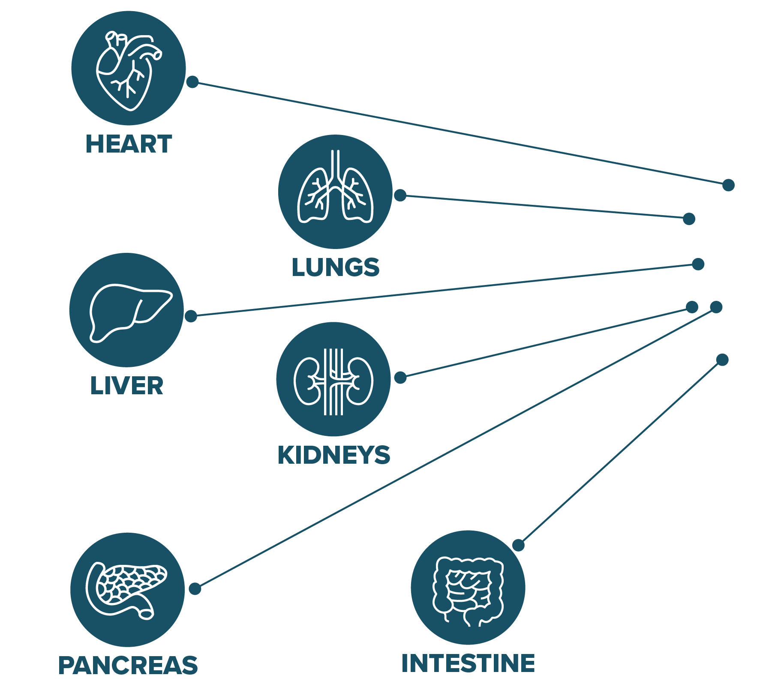

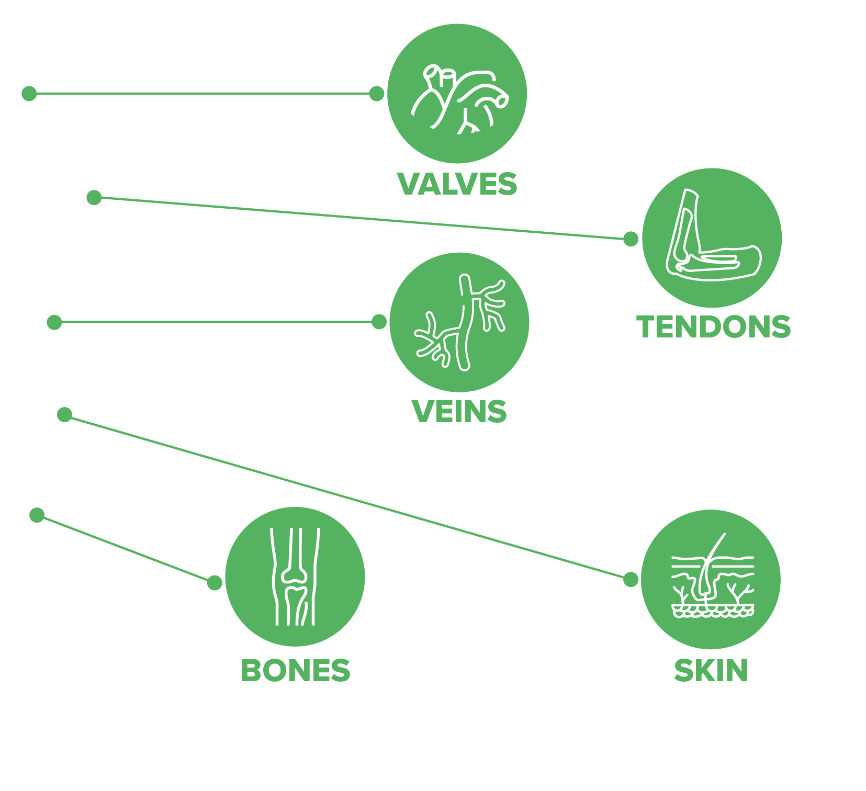
83 lives

Slide 16


Imagine what it would feel like if you needed a cornea transplant. The left side simulates that feeling.
A person who chooses to be a tissue donor could heal up to 75 people through donation of corneas, bone grafts,
skin grafts, veins and heart valves.

Slide 17
What now?

Slide 18
Be an advocate for donation
Start a Student Organ Donation Advocate (SODA) Club at your school.
Run a registration drive to sign up new organ donors.
Have your next project be about organ
donation.

Slide 19
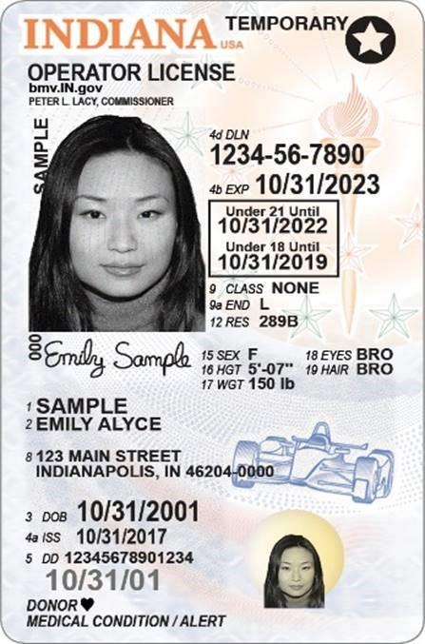
Think about signing up
At a license branch (BMV).
Online at DonateLifeIndiana.org.
On the “Health app” on an iPhone.

Slide 20
Visit Donate Life Indiana’s YouTube channel to watch more real-life Indiana donation and transplantation stories.
For videos to play, you must be in slide show/presentation mode before clicking.
https://www.youtube.com/user/donatelifeindiana/videos
Notes:
Receive

Slide 21
Want to learn more? Click on each link below.
For video to play, you must be in slide show/presentation mode before clicking.
Donation process (video)
Donate Life Indiana
U.S. government information

Slide 22
Do you have questions, want additional resources or know someone interested in booking a free Donate Life Indiana speaker?
Visit donatelifeindiana.org/educators

